Slide 1
Sales Analysis Project
Sales Analysis of Various Products Over Multiple Time Periods
Rohit Rai

Slide 2
Contents
1. Introduction
2. Data Collection
(i) Importing Libraries
(ii) Gathering Data Files
(iii) Consolidating Data
3. Best Month for Sales
4. City with Maximum Orders
5. Most Sold Product and Analysis
6. Trend Analysis of the Most Sold Product
7. Frequently Sold Together Products
8. Conclusion

Slide 3
Introduction
The sales analysis project focuses on examining the sales data to derive meaningful insights that can aid in enhancing business strategies and decision-making processes. By leveraging Python and its data analysis libraries, we explore various dimensions of sales data to answer key questions about sales performance, geographical trends, product popularity, and buying patterns. The primary objectives of this project include:
1. Identifying the best months for sales to optimize promotional activities and inventory management.
2. Analyzing geographical sales data to determine which cities have the highest number of orders.
3. Investigating the most sold products and understanding the factors driving their popularity.
4. Examining the sales trends of the most sold products to anticipate future demand.
5. Understanding which products are often purchased together to suggest effective bundling strategies.
This comprehensive analysis will provide valuable insights that can help businesses enhance their sales performance and improve customer satisfaction.

Slide 4
Data Collection
Importing Libraries
To begin the analysis, we import essential libraries such as pandas for data manipulation, numpy for numerical operations, matplotlib and seaborn for data visualization. These libraries provide powerful tools for cleaning, transforming, and visualizing data, essential for extracting meaningful insights.
Gathering Data Files
Data collection involves gathering multiple CSV files that contain historical sales data. Using the glob module, we dynamically collect file paths based on specified patterns, ensuring we have all necessary data files for analysis.
Consolidating Data
The gathered data is consolidated into a single DataFrame using pandas. This step involves reading each CSV file into a DataFrame and merging them to create a unified dataset. This consolidated data is then used for the subsequent analysis.

Slide 5
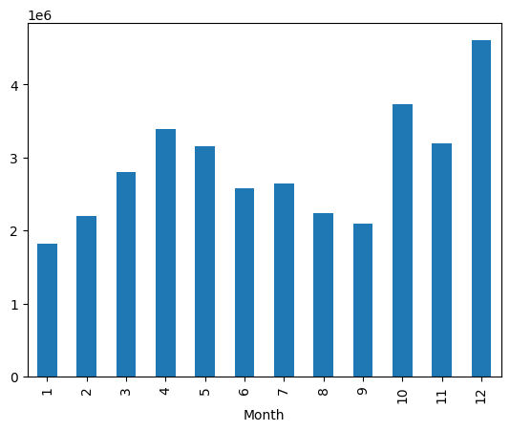
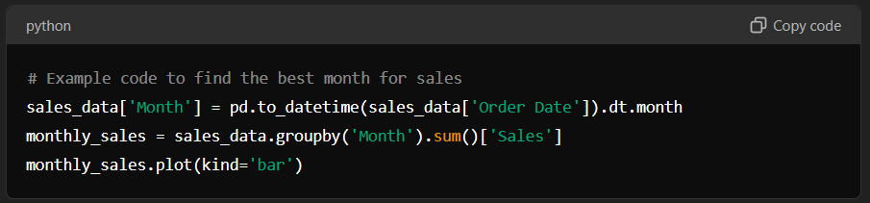
Best Month for Sales
In this section, we analyze the sales data to determine which month has the highest sales. By plotting the monthly sales data, we can identify trends and patterns that indicate peak sales periods.

Slide 6
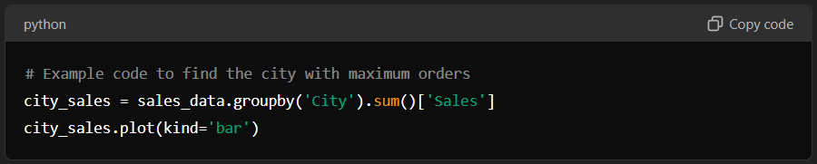
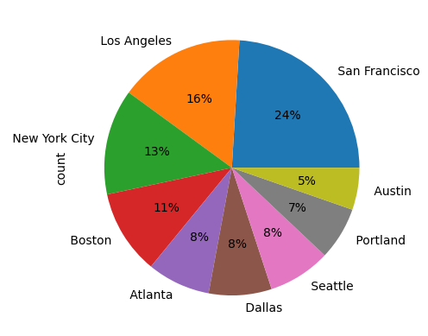
City with Maximum Orders
This section focuses on identifying which city has the highest number of orders. By analyzing geographical sales data, businesses can target their marketing efforts more effectively.

Slide 7
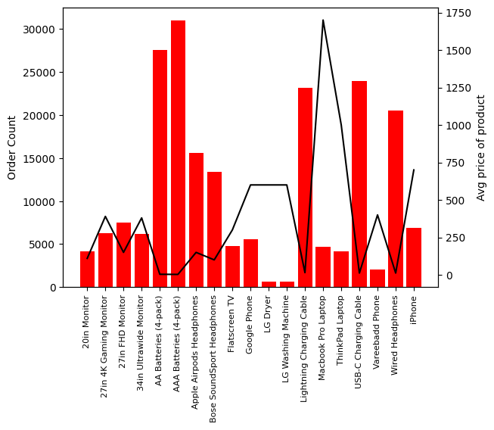
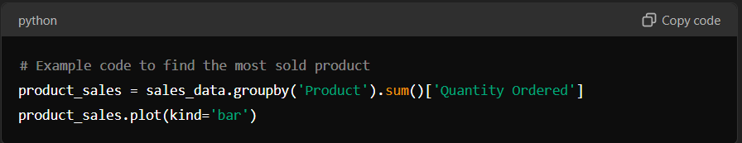
Most Sold Product and Analysis
Here, we analyze the data to find out which product is sold the most and explore the reasons behind its popularity.

Slide 8
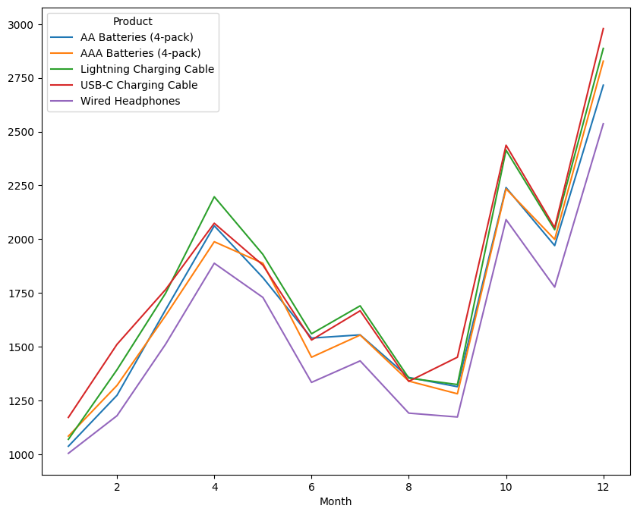
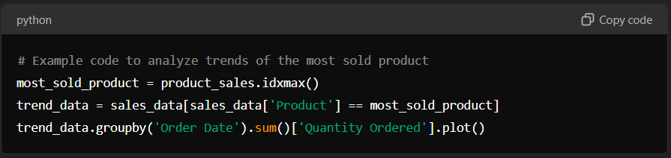
Trend Analysis of the Most Sold Product
In this section, we analyze the sales trends of the most sold product over time to anticipate future demand.

Slide 9
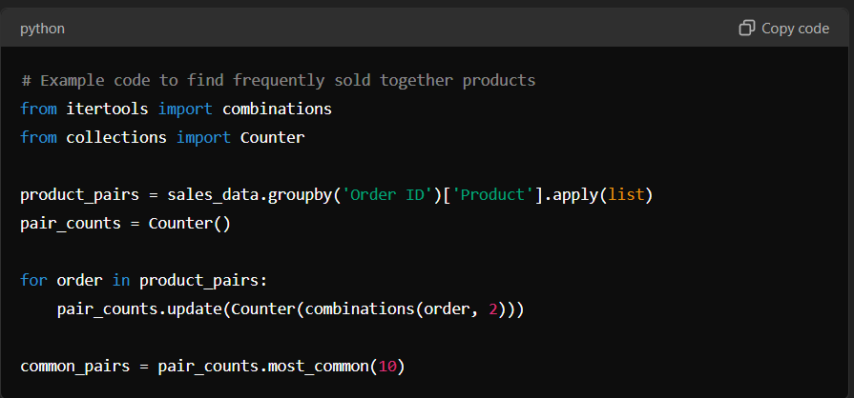
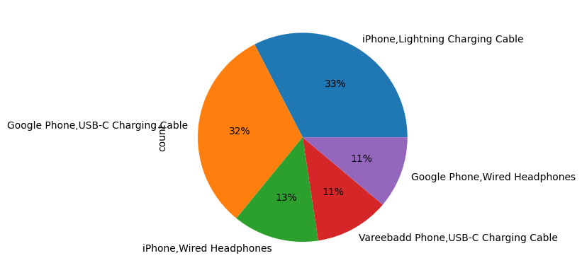
Frequently Sold Together Products
We explore which products are frequently bought together to suggest effective bundling strategies.

Slide 10
Conclusion
The sales analysis project successfully identified key insights that can drive business growth and efficiency. The analysis revealed the best months for sales, enabling better inventory planning and promotional strategies. It highlighted the top-performing cities, providing a focus for regional marketing efforts. The most sold products and their underlying reasons were examined, aiding in product development and inventory management. Trend analysis of top-selling products offered predictive insights for future sales. Additionally, understanding product bundling patterns provided opportunities for increasing sales through effective bundling strategies.
Overall, this project demonstrates the power of data-driven decision-making in optimizing sales performance and enhancing business operations. The insights derived from this analysis can serve as a foundation for strategic planning and continuous improvement in sales and marketing efforts.

Slide 11
Thank You

